Slide 1
Introduction to Programming Language (Java)
Fariha Zahin
Lecturer
CSE, Southeast University

Slide 2
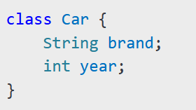
What is a Class?
A class is a blueprint for creating objects.
It defines attributes (variables) and behaviors (methods).
Example:

Slide 3
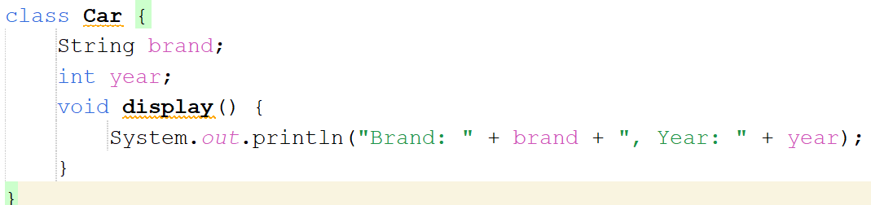
Creating a Class in Java
Define a class with attributes and methods.
Example:

Slide 4
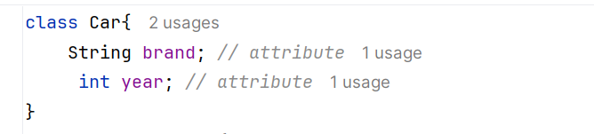
Attributes / Fields / Instance Variables
A variable which is created inside the class but outside the method is known as an instance variable.
Example:

Slide 5
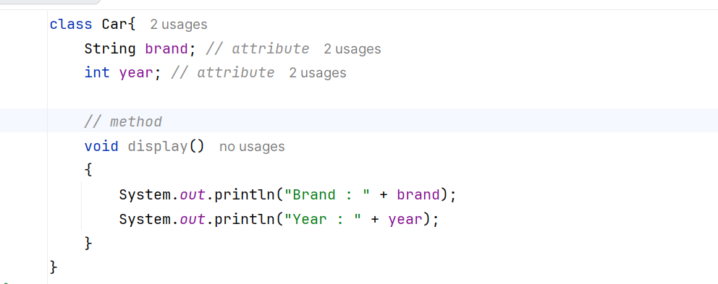
Methods
In Java, a method is like a function which is used to expose the behavior of an
object.
Example:

Slide 6

What is an Object?
An object is an instance of a class.
It holds actual values and can invoke methods.
Example:

Slide 7
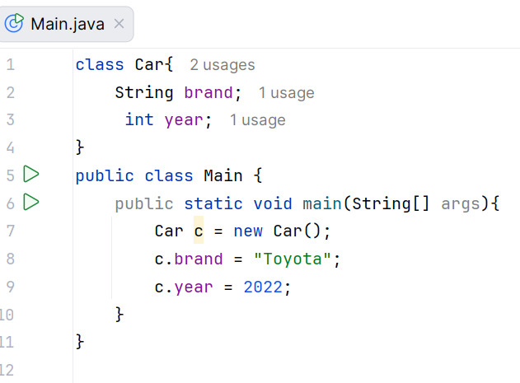
Creating Objects in Java
1.Instantiate a class using the new keyword..
Understanding the new keyword:
The new keyword dynamically allocates memory for an object.
It returns a reference to the newly created object.

Slide 8
Initializing Objects in Java
There are 3 ways to Initialize an object
By reference
By method
By Constructor

Slide 9
Initializing Objects in Java
By reference

Slide 10
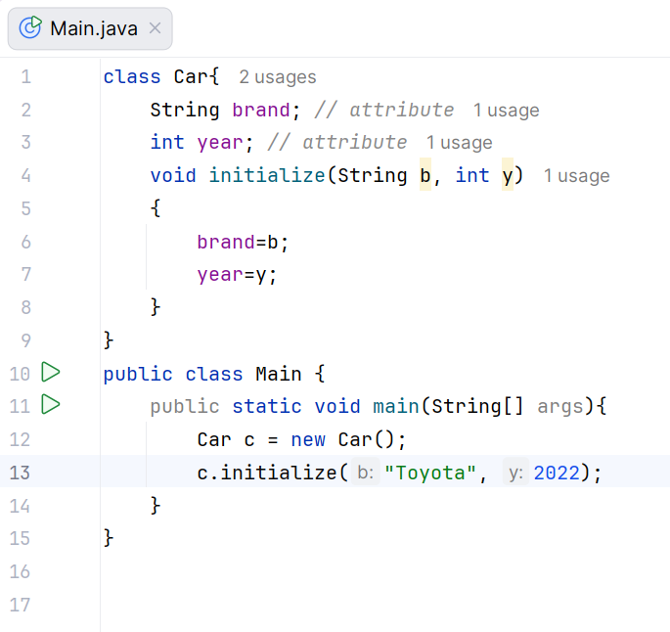
Initializing Objects in Java
2. By method

Slide 11
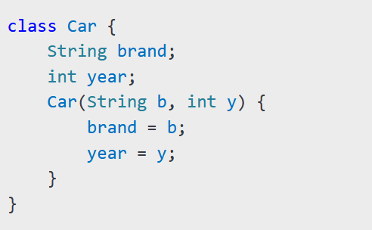
3 . By Constructors
A constructor initializes objects.
Properties of a Constructor in Java
1.Same Name as Class
  A constructor must have the same name as the class.
No Return Type
  A constructor does not have a return type, not even void
Automatically Called
  It is automatically invoked when an object of the class is created.
Can Be Overloaded
  Multiple constructors can be defined with different parameters (Constructor Overloading).
Cannot Be Inherited
  Constructors are not inherited by subclasses, but a subclass can call the parent class constructor using super keyword.

Slide 12
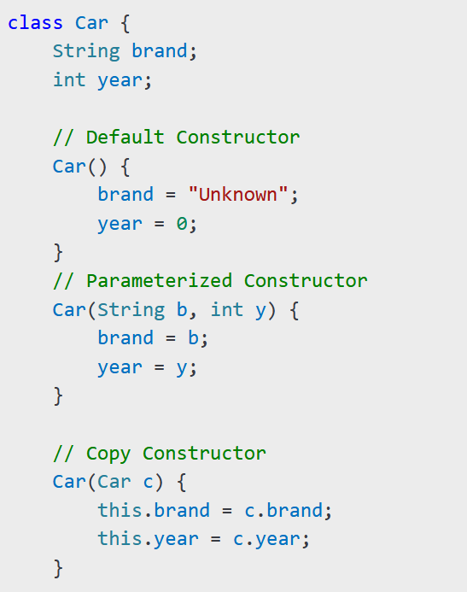
Types of Constructors:
Default Constructor - No parameters, initializes default values.
Parameterized Constructor - Takes arguments to initialize object properties.
Copy Constructor - Creates a new object by copying another object's values.

Slide 13
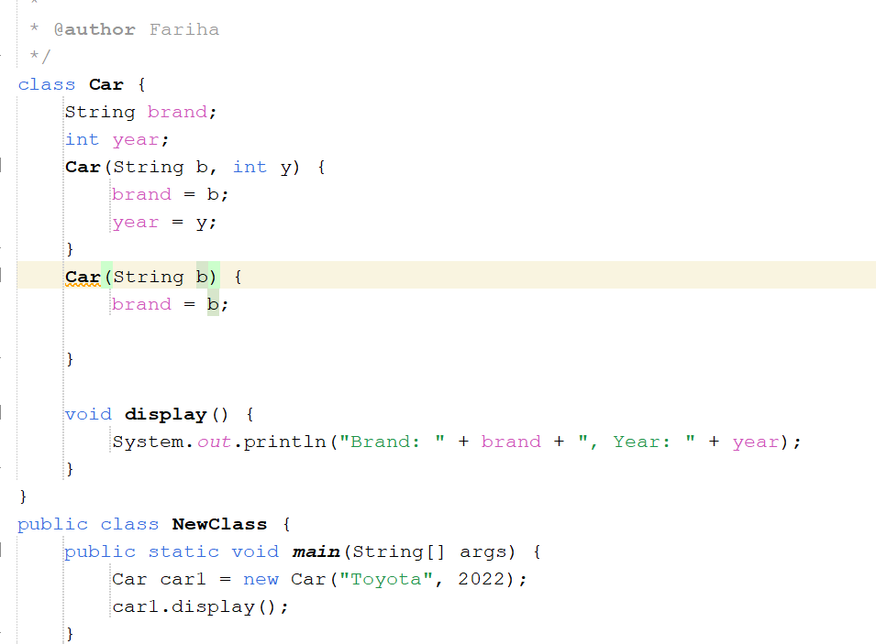
Constructor Overloading in Java
Definition:
Constructor overloading in Java allows a class to have multiple constructors with different parameter lists. The appropriate constructor is selected based on the arguments passed during object creation.

Slide 14
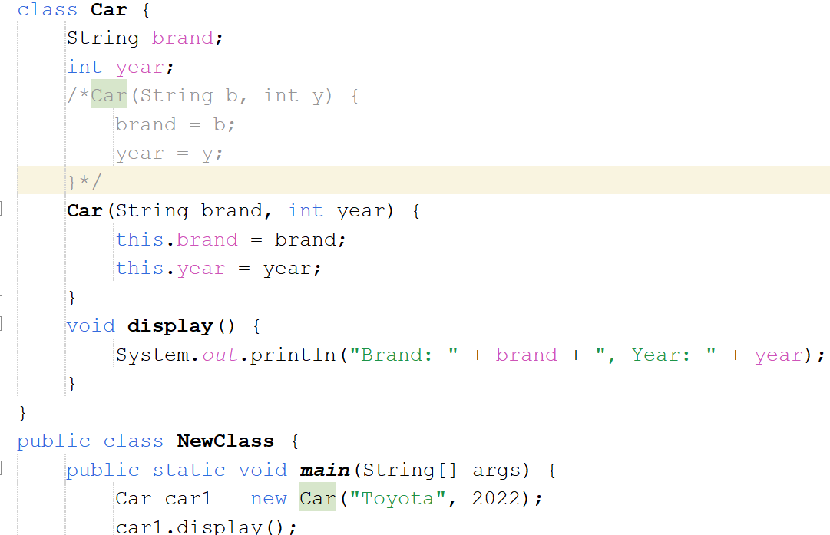
Use of this keyword:
this keyword in Java refers to the current object of the class. It is used to refer to the current object's instance variables, methods, and constructors.
It is commonly used in constructors to distinguish between instance variables and parameters when they have the same name.

Slide 15
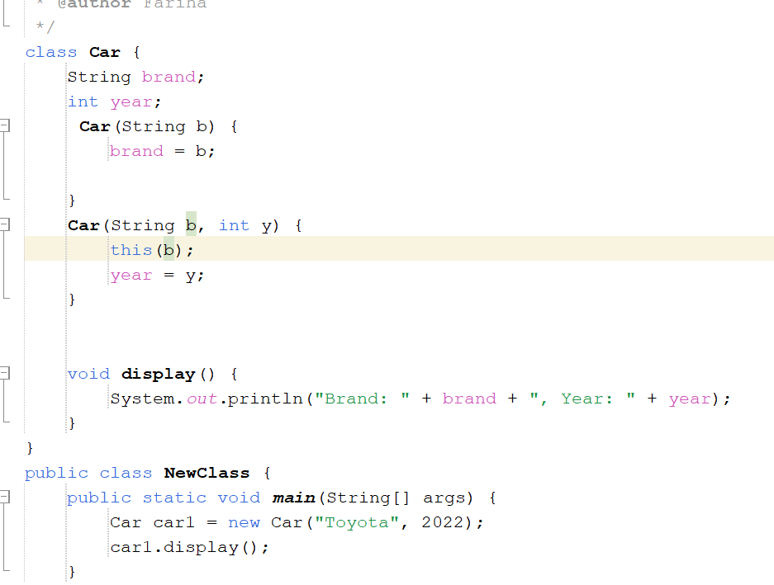
this() must be the first statement in a constructor.
Helps in constructor chaining within the same class.
Constructor chaining is the process of calling one constructor from another constructor within the same class or from a parent class using this(). It helps reduce code duplication and improves reusability.

Slide 16
